Slide 1
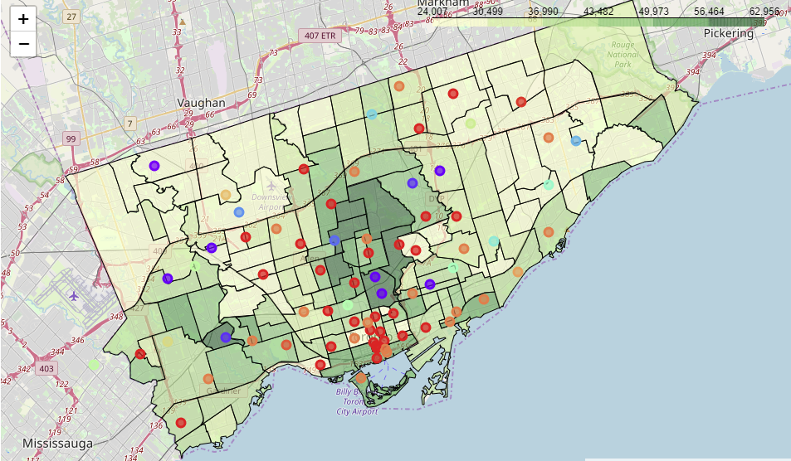
Toronto Neighborhood Analysis
Visualizations for Potential New-Movers
by: Patrick de Guzman

Slide 2
Problem Statement
Problem:
The research process for potential new-movers is daunting and a deep understanding of the character of each neighborhood in a new city is difficult to obtain.
Target:
Potential new-movers to Toronto, Ontario.
Solution:
Simple visualization tools to highlight dimensions that are relevant in the new-mover’s decision-making process.
Choropleth maps of Toronto developed to layer distributions of income, age, household sizes, unit sizes, and neighborhood ‘character’.

Slide 3
Data Used
Toronto neighborhoods (by postal code) & coordinates
Toronto neighborhood coordinate boundaries (GeoJSON format)
Venue type data per neighborhood (Foursquare API)
City of Toronto statistics: Age, income, household sizes, unit sizes (Census data)

Slide 4
Methodology
Key Dimensions for Consideration: Per neighborhood, distribution of:
Average Age
Average Income
Average Household Sizes
Average Unit Sizes
Neighborhood ‘character’ (determined by most common venue types)
Choropleth mapping:
to visualize distributions of the quantitative dimensions (age, income, household size, unit size)
K-means Clustering:
to visualize clusters of neighborhoods based on most common venue types
To perform k-means clustering, the occurrence of each unique venue type within each neighborhood was quantified using one-hot encoding and subsequently ranked (within a 250m radius from the ‘center’ of the neighborhood via its coordinates).

Slide 5
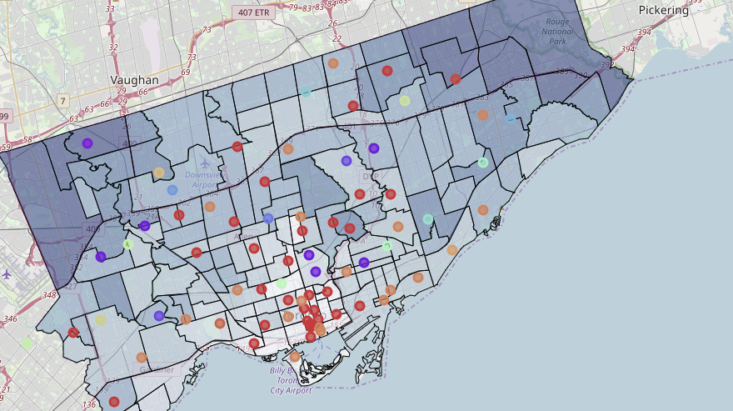
Key Neighborhood Clusters
Falafel restaurants
Festival events
Fields/parks/dog parks
Yoga studios
Fast food
Festival events
Farmer’s markets
Fields/parks
Coffee shops/cafes
Restaurants
Fast food
Italian/pizza joints

Slide 6
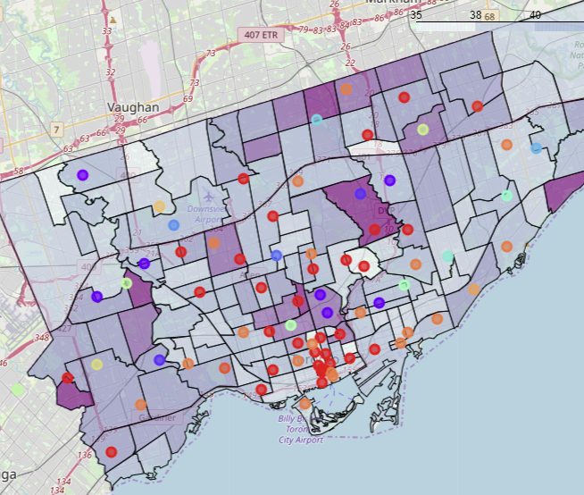
Results & Observations: Age
Younger residents around the Downtown core (circled) and towards Vaughan (upper left)
Average age increasing towards Midtown, Uptown (circled), and towards Markham (north region)

Slide 7
Results & Observations: Income
Average income increases towards the Midtown & Uptown neighborhoods (circled)
Average income decreases along outskirts of Toronto, but slightly less so in Mississauga area (Southwest region)

Slide 8
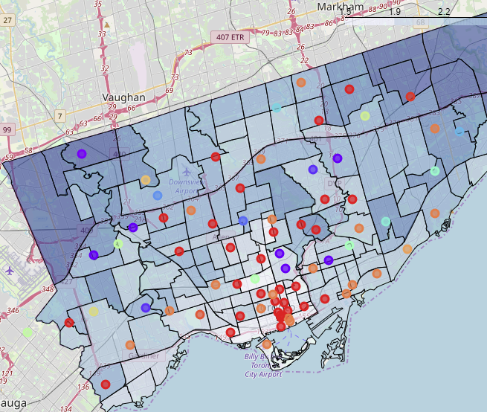
Results & Observations: Household Size
Average number of individuals within a unit remains relatively low within the downtown core
Average household size increases along outskirts of Toronto (regions of detached houses for larger families)

Slide 9
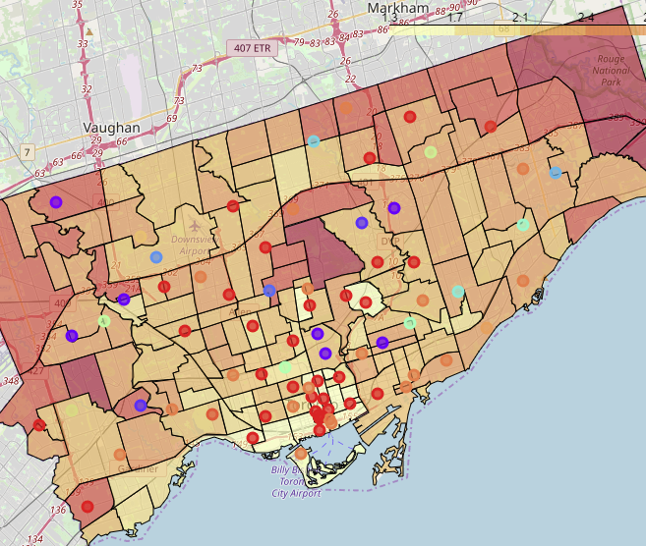
Results & Observations: Unit Size
Similar distribution pattern to household size map; Fewer bedrooms per unit around the Downtown core, greater number of bedrooms around outskirts.

Slide 10
Conclusion
Limitations:
In some neighborhoods, quantity of venue data points was low, potentially skewing the portrayed neighborhood character compared to those that returned many data points from the Foursquare API request.
City of Toronto statistics for age, income, household size, and unit size sourced from the 2016 census.
Future:
Plans to extend the analysis to include:
1. Household/Rental price data
2. Analysis of other major Canadian cities (e.g., Vancouver, Montreal)

Slide 11
References
[1] Toronto Postal Code & Neighborhoods (Wikipedia), url: https://en.wikipedia.org/wiki/List_of_postal_codes_of_Canada:_M
[2] Toronto GeoJSON Data (GitHub: Adamw523), url: http://adamw523.com/toronto-geojson/
[3] Toronto Neighborhood Data (City of Toronto): Age, Income, Household Sizes, Unit Sizes, url: https://open.toronto.ca/dataset/neighbourhood-profiles/
[4] Toronto Neighborhood Venue Data (Foursquare), url: https://foursquare.com/
[5] Geospatial Data (Coursera), url: https://cocl.us/Geospatial_data
[6] Final Visualization Maps (nbviewer), url: https://nbviewer.jupyter.org/github/Patrickdg/Toronto-Neighborhood-Visualization-for-Potential-Movers/blob/master/Neighborhood%20Visualization%20Maps.ipynb
[7] Source code (GitHub), url: https://github.com/Patrickdg/Toronto-Neighborhood-Visualization-for-Potential-Movers

Slide 12
End

